Slide 1


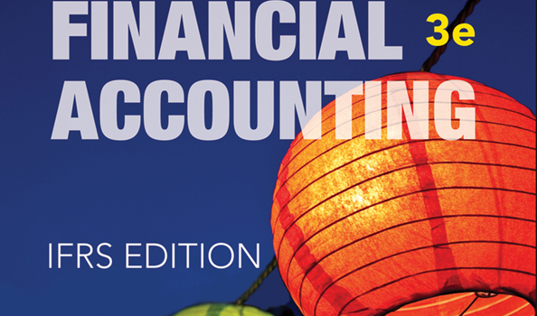
WILEY
IFRS EDITION
Prepared by
Coby Harmon
University of California, Santa Barbara
Westmont College

Slide 2
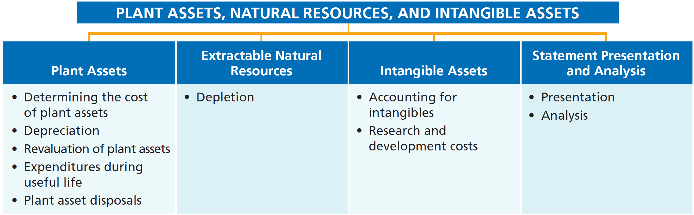
PREVIEW OF CHAPTER 9
Financial Accounting
IFRS 3rd Edition
Weygandt ● Kimmel ● Kieso

Slide 3
CHAPTER
9
Plant Assets, Natural Resources, and Intangible Assets
LEARNING OBJECTIVES
After studying this chapter, you should be able to:
Describe how the historical cost principle applies to plant assets.
Explain the concept of depreciation and how to compute it.
Distinguish between revenue and capital expenditures, and explain the entries for each.
Explain how to account for the disposal of a plant asset.
Compute periodic depletion of extractable natural resources.
Explain the basic issues related to accounting for intangible assets.
Indicate how plant assets, natural resources, and intangible assets are reported.

Slide 4
Plant Assets
Learning Objective 1
Describe how the
historical cost principle applies to plant assets.
Plant assets are resources that have
  physical substance (a definite size and
  shape),
  are used in the operations of a business,
  are not intended for sale to customers,
  are expected to provide service to the company for a number of years.
Referred to as property, plant, and equipment; plant and equipment; and fixed assets.
LO 1

Slide 5
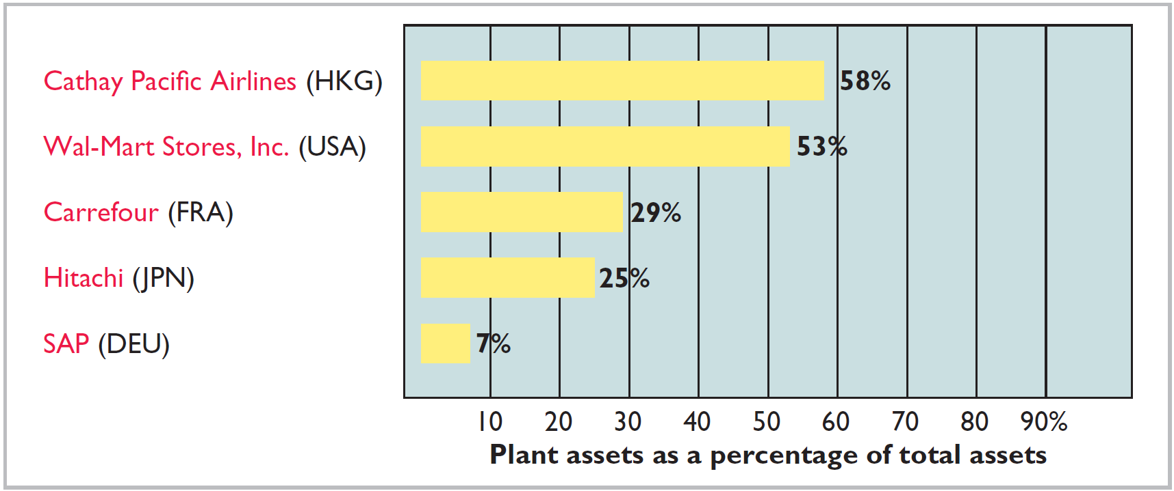
Plant Assets
Plant assets are critical to a company’s success.
Illustration 9-1
Percentages of plant assets in relation to total assets
LO 1

Slide 6
Determining the Cost of Plant Assets
The historical cost principle requires that companies record plant assets at cost.
Cost consists of all expenditures necessary to acquire an asset and make it ready for its intended use.
LO 1

Slide 7
Determining the Cost of Plant Assets
LAND
All necessary costs incurred in making land ready for its intended use increase (debit) the Land account.
  Costs typically include:
    cash purchase price,
    closing costs such as title and attorney’s fees,
    real estate brokers’ commissions,
    accrued property taxes and other liens assumed by the purchaser, and
    clearing, leveling, demo of existing structures.
LO 1

Slide 8
Determining the Cost of Plant Assets
Illustration: Lew Company Ltd. acquires real estate at a cash cost of HK$2,000,000. The property contains an old warehouse that is razed at a net cost of HK$60,000 (HK$75,000 in costs less HK$15,000 proceeds from salvaged materials). Additional expenditures are the attorney’s fee, HK$10,000, and the real estate broker’s commission, HK$80,000.
Required: Determine the amount to be reported as the cost of the land.
LO 1

Slide 9
Determining the Cost of Plant Assets
Required: Determine amount to be reported as the cost of the land.
Land
Cash price of property (HK$2,000,000)
HK$2,000,000
Net removal cost of warehouse (HK$60,000)
60,000
Attorney's fees (HK$10,000)
10,000
Real estate broker’s commission (HK$80,000)
80,000
Cost of Land
HK$2,150,000
Entry to record the acquisition of the land:
Land 2,150,000
Cash 2,150,000
LO 1

Slide 10
Determining the Cost of Plant Assets
LAND IMPROVEMENTS
  Includes all expenditures necessary to make the improvements ready for their intended use.
  Examples: driveways, parking lots, fences, landscaping, and lighting.
  Limited useful lives.
  Expense (depreciate) the cost of land improvements over their useful lives.
LO 1

Slide 11
Determining the Cost of Plant Assets
BUILDINGS
Includes all costs related directly to purchase or construction.
Purchase costs:
  Purchase price, closing costs (attorney’s fees, title insurance, etc.) and real estate broker’s commission.
  Remodeling and replacing or repairing the roof, floors, electrical wiring, and plumbing.
Construction costs:
  Contract price plus payments for architects’ fees, building permits, and excavation costs.
LO 1

Slide 12
Determining the Cost of Plant Assets
EQUIPMENT
Include all costs incurred in acquiring the equipment and preparing it for use.
Costs typically include:
  Cash purchase price.
  Sales taxes.
  Freight charges.
  Insurance during transit paid by the purchaser.
  Expenditures required in assembling, installing, and testing the unit.
LO 1

Slide 13
Determining the Cost of Plant Assets
Illustration: Zhang Company purchases factory machinery at a cash price of HK$500,000. Related expenditures are for sales taxes HK$30,000, insurance during shipping HK$5,000, and installation and testing HK$10,000. Compute the cost of the machinery.
Machinery
Cash price
HK$500,000
Sales taxes
30,000
Insurance during shipping
5,000
Installation and testing
10,000
Cost of Machinery
HK$545,000
LO 1

Slide 14
Determining the Cost of Plant Assets
Illustration: Zhang Company purchases factory machinery at a cash price of HK$500,000. Related expenditures are for sales taxes HK$30,000, insurance during shipping HK$5,000, and installation and testing HK$10,000. Prepare the journal entry to record these costs.
Equipment 545,000
Cash 545,000
LO 1

Slide 15
Determining the Cost of Plant Assets
Illustration: Huang Company purchases a delivery truck at a cash price of HK$420,000. Related expenditures are sales taxes HK$13,200, painting and lettering HK$5,000, motor vehicle license HK$800, and a three-year accident insurance policy HK$16,000. Compute the cost of the delivery truck.
Truck
Cash price
HK$420,000
Sales taxes
13,200
Painting and lettering
5,000
Cost of Delivery Truck
HK$438,200
LO 1

Slide 16
Determining the Cost of Plant Assets
Illustration: Huang Company purchases a delivery truck at a cash price of HK$420,000. Related expenditures are sales taxes HK$13,200, painting and lettering HK$5,000, motor vehicle license HK$800, and a three-year accident insurance policy HK$16,000. Prepare the journal entry to record these costs.
Equipment 438,200
License Expense 800
Prepaid Insurance 16,000
Cash 455,000
LO 1

Slide 17
ACCOUNTING ACROSS THE ORGANIZATION
Many Firms Use Leases
Leasing is big business. Who does the most leasing? AWAS (IRL), J.P. Morgan Leasing (USA), and ICBC (CHN) are major lessors. Also, many companies have established separate leasing companies, such as Boeing Capital Corporation (USA), Mitsubishi Heavy Industries (JPN), and John Deere Capital Corporation (USA). And, as an excellent example of the magnitude of leasing, leased planes account for a high percentage of commercial airlines. Leasing is also becoming more common in the hotel industry. Marriott (USA), Hilton (USA), and InterContinental (GBR) are increasingly choosing to lease hotels that are owned by someone else.
LO 1

Slide 18
Depreciation
Learning Objective 2
Explain the concept
of depreciation and
how to compute it.
  Process of allocating to expense the cost
  of a plant asset over its useful (service) life
  in a rational and systematic manner.
  Process of cost allocation, not asset valuation.
  Applies to land improvements, buildings, and equipment, not land.
  Depreciable, because the revenue-producing ability of asset will decline over the asset’s useful life.
LO 2

Slide 19
Depreciation
Question
Depreciation is a process of:
  valuation.
  cash accumulation.
  cost allocation.
  appraisal.
LO 2

Slide 20
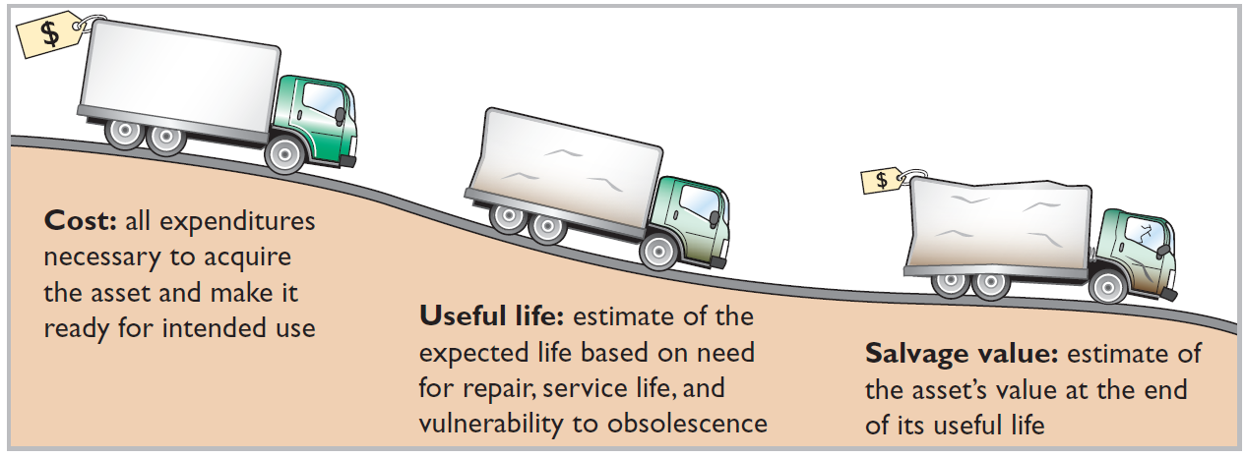
FACTORS IN COMPUTING DEPRECIATION
Illustration 9-6
Three factors in computing depreciation
• HELPFUL HINT
Depreciation expense is reported on the income statement. Accumulated depreciation is reported on the balance sheet as a deduction from plant assets.
LO 2

Slide 21
DEPRECIATION METHODS
Management selects the method it believes best measures an asset’s contribution to revenue over its useful life.
Examples include:
  Straight-line method
  Units-of-activity method
  Declining-balance method
LO 2

Slide 22
DEPRECIATION METHODS
Illustration: Bob’s Florist purchased a small delivery truck on January 1, 2017.
Cost €13,000
Expected residual value €1,000
Estimated useful life in years 5
Estimated useful life in miles 100,000
Required: Compute depreciation using the following.
(a) Straight-Line. (b) Units-of-Activity. (c) Declining-Balance.
LO 2

Slide 23
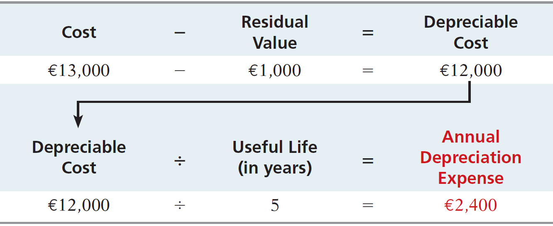
STRAIGHT-LINE METHOD
Expense is same amount for each year.
Depreciable cost = Cost less salvage value.
ILLUSTRATION 9-8
Formula for straight-line method
LO 2

Slide 24
STRAIGHT-LINE METHOD
Illustration:
Illustration 9-9
Straight-line depreciation
schedule
2017
€ 12,000
20%
€ 2,400
€ 2,400
€ 10,600
2018
12,000
20
2,400
4,800
8,200
2019
12,000
20
2,400
7,200
5,800
2020
12,000
20
2,400
9,600
3,400
2021
12,000
20
2,400
12,000
1,000
2017
Journal Entry
Depreciation Expense 2,400
Accumulated Depreciation 2,400
LO 2

Slide 25
STRAIGHT-LINE METHOD
Partial Year
Illustration:
Assume the delivery truck was purchased on April 1, 2017.
LO 2

Slide 26
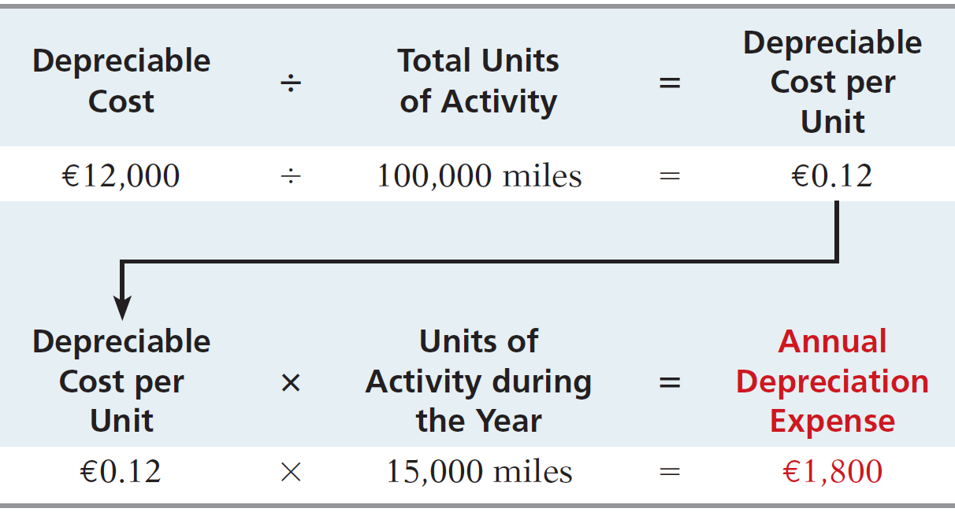
UNITS-OF-ACTIVITY METHOD
Companies estimate total units of activity to calculate depreciation cost per unit.
Expense varies based on units of activity.
Depreciable cost is cost less residual value.
Illustration 9-10
Formula for units-of-activity method
LO 2

Slide 27
UNITS-OF-ACTIVITY METHOD
Illustration:
Illustration 9-11
Units-of-activity depreciation
schedule
2017
15,000
€ 0.12
€ 1,800
€ 1,800
€ 11,200
2018
30,000
0.12
3,600
5,400
7,600
2019
20,000
0.12
2,400
7,800
5,200
2020
25,000
0.12
3,000
10,800
2,200
2021
10,000
0.12
1,200
12,000
1,000
2017
Journal Entry
Depreciation Expense 1,800
Accumulated Depreciation 1,800
LO 2

Slide 28
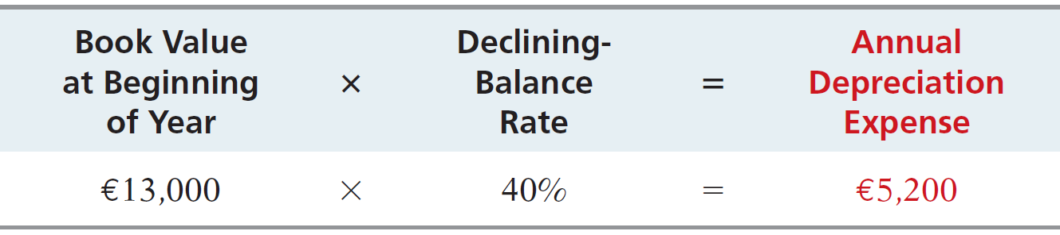
DECLINING-BALANCE METHOD
  Accelerated method.
  Decreasing annual depreciation expense over the asset’s useful life.
  Twice the straight-line rate with Double-Declining-Balance.
  Rate applied to book value.
Illustration 9-12
Formula for declining-balance method
LO 2

Slide 29
DECLINING-BALANCE METHOD
Illustration:
Illustration 9-13
Double-declining-balance depreciation schedule
2017
€ 13,000
40%
€ 5,200
€ 5,200
€ 7,800
2018
7,800
40
3,120
8,320
4,680
2019
4,680
40
1,872
10,192
2,808
2020
2,808
40
1,123
11,315
1,685
2021
1,685
40
685*
12,000
1,000
2017
Journal Entry
Depreciation Expense 5,200
Accumulated Depreciation 5,200
* Computation of €674 (€1,685 x 40%) is adjusted to €685.
LO 2

Slide 30
DECLINING-BALANCE METHOD
Partial Year
Illustration:
LO 2

Slide 31
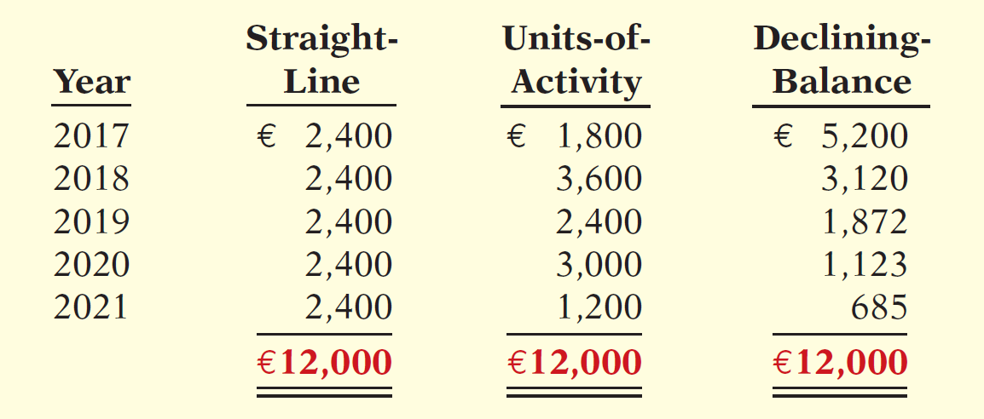
COMPARISON OF METHODS
ILLUSTRATION 9-14
Comparison of depreciation methods
Annual depreciation varies considerably among the methods, but total depreciation expense is the same (€12,000) for the five-year period.
LO 2

Slide 32
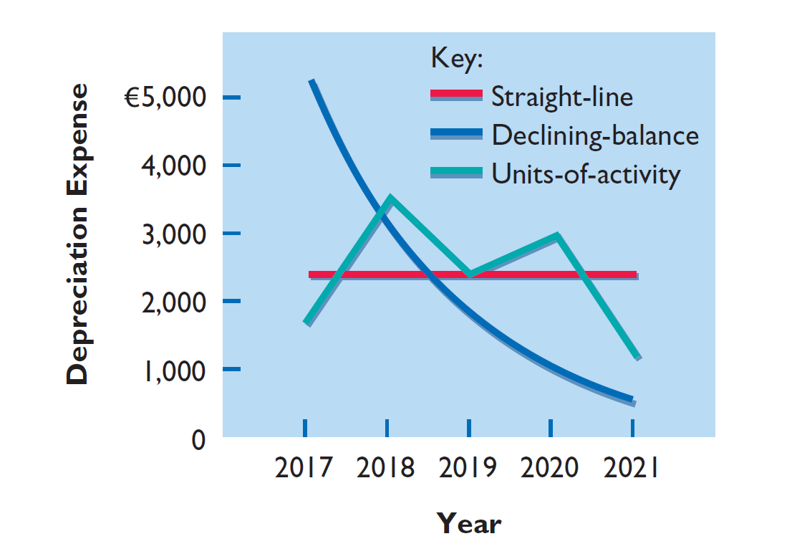
COMPARISON OF METHODS
ILLUSTRATION 9-15
Patterns of depreciation
LO 2

Slide 33
Depreciation
COMPONENT DEPRECIATION
  IFRS requires component depreciation for plant assets.
  Requires that any significant parts of a plant asset that have significantly different estimated useful lives should be separately depreciated.
LO 2

Slide 34
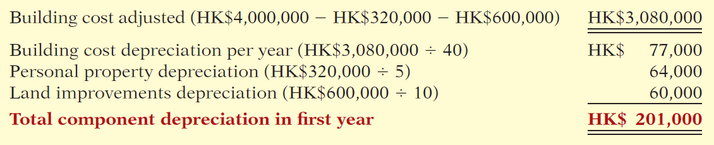
COMPONENT DEPRECIATION
Illustration: Lexure Construction builds an office building for HK$4,000,000. The building is estimated to have a 40-year useful life, however HK$320,000 of the cost of the building relates to personal property and HK$600,000 relates to land improvements. Because the personal property has a depreciable life of 5 years and the land improvements have a depreciable life of 10 years, Lexure must use component depreciation. Assuming that Lexure uses straight-line depreciation and no residual value, component depreciation for the first year of the office building is computed as follows.
Illustration 9-16
Component depreciation computation
LO 2

Slide 35
Depreciation
DEPRECIATION AND INCOME TAXES
Tax laws often do not require corporate taxpayers to use the same depreciation method on the tax return that is used in preparing financial statements.
Many corporations use
  straight-line in their financial statements to maximize net income.
  an accelerated-depreciation method on their tax returns to minimize their income taxes.
LO 2

Slide 36
Depreciation
REVISING PERIODIC DEPRECIATION
Accounted for in the period of change and future periods (change in estimate).
No restatement of prior years’ depreciation expense.
LO 2

Slide 37
REVISING PERIODIC DEPRECIATION
Illustration: Arcadia HS, purchased equipment for €510,000 which was estimated to have a useful life of 10 years with a residual value of €10,000 at the end of that time. Depreciation has been recorded for 7 years on a straight-line basis. In 2020 (year 8), it is determined that the total estimated life should be 15 years with a residual value of €5,000 at the end of that time.
Questions:
  What is the journal entry to correct prior years’ depreciation expense?
  Calculate the depreciation expense for 2020.
No Entry
Required
LO 2

Slide 38
REVISING PERIODIC DEPRECIATION
Equipment cost €510,000
Residual value - 10,000
Depreciable base 500,000
Useful life (original) 10 years
Annual depreciation € 50,000
First, establish NBV at date of change in estimate.
x 7 years = €350,000
Balance Sheet (Dec. 31, 2019)
Property, Plant, and Equipment
Equipment
€510,000
Accumulated depreciation
350,000
Net book value (NBV)
€160,000
LO 2

Slide 39
REVISING PERIODIC DEPRECIATION
Net book value €160,000
Residual value (new) 5,000
Depreciable base 155,000
Useful life remaining 8 years
Annual depreciation € 19,375
Depreciation Expense calculation for 2020.
Journal entry for 2020 and future years.
Depreciation Expense 19,375
Accumulated Depreciation 19,375
LO 2

Slide 40
REVISING PERIODIC DEPRECIATION
Question
When there is a change in estimated depreciation:
  previous depreciation should be corrected.
  current and future years’ depreciation should be revised.
  only future years’ depreciation should be revised.
  None of the above.
LO 2

Slide 41
>
DO IT!
Chambers plc purchased a piece of equipment for £36,000. It estimated a 6-year life and £6,000 salvage value. Thus, straight-line depreciation was £5,000 per year [(£36,000 − £6,000) ÷ 6]. At the end of year three (before the depreciation adjustment), it estimated the new total life to be 10 years and the new salvage value to be £2,000. Compute the revised depreciation.
Original depreciation expense = [(£36,000 − £6,000) ÷ 6] = £5,000
Accumulated depreciation after 2 years = 2 × £5,000 = £10,000
Book value = £36,000 − £10,000 = £26,000
Book value after 2 years of depreciation £26,000
Less: New salvage value 2,000
Depreciable cost £24,000
Remaining useful life 8 years
Revised annual depreciation (£24,000 ÷ 8) £ 3,000
LO 2

Slide 42
Revaluation of Plant Assets
IFRS allows companies to revalue plant assets to fair value at the reporting date.
If revaluation is used,
  it must be applied to all assets in a class of assets.
  assets experiencing rapid price changes must be revalued on an annual basis.
LO 2

Slide 43
Revaluation of Plant Assets
Illustration: Pernice Ltd. applies revaluation to equipment purchased on January 1, 2017, for HK$1,000,000. The equipment has a useful life of 5 years, and no residual value. Pernice makes the following entry to record depreciation for 2017, assuming straight-line depreciation.
Depreciation Expense 200,000
Accumulated Depreciation—Equipment 200,000
At the end of 2017, independent appraisers determine that the asset has a fair value of HK$850,000. The entry to record the revaluation is as follows.
Accumulated Depreciation—Equipment 200,000
Equipment 150,000
Revaluation Surplus 50,000
LO 2

Slide 44
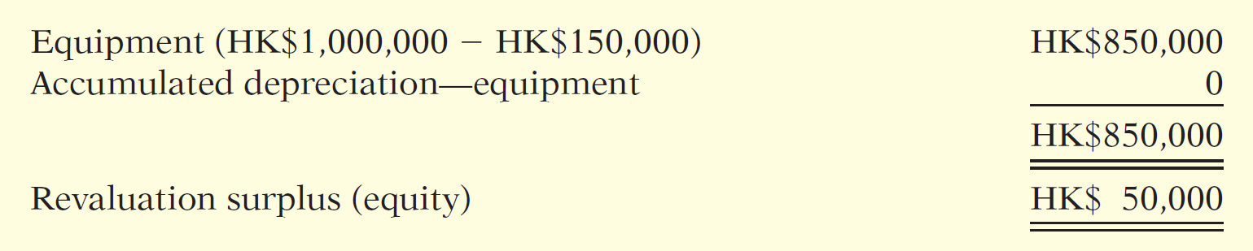
Revaluation of Plant Assets
Illustration 9-18
Statement presentation of plant assets (equipment) and revaluation surplus
As indicated,
  HK$850,000 is the new basis of the asset.
  Depreciation expense of HK$200,000 in the income statement.
  HK$50,000 in other comprehensive income.
  Assuming no change in the total useful life, depreciation in year 2 will be HK$212,500 (HK$850,000 ÷ 4).
LO 2

Slide 45
Revaluation of Plant Assets
Illustration: Assume again that Pernice’s equipment has a carrying amount of HK$800,000 (HK$1,000,000 − HK$200,000). However, at the end of 2017, independent appraisers determine that the asset has a fair value of HK$775,000, which results in an impairment loss of HK$25,000 (HK$800,000 − HK$775,000). To record the equipment at fair value and to record this loss, Pernice makes the following entry.
Accumulated Depreciation—Equipment 200,000
Impairment Loss 25,000
Equipment 225,000
The impairment loss of HK$25,000 reduces net income.
LO 2

Slide 46
Expenditures During Useful Life
Learning Objective 3
Distinguish between
revenue and capital
expenditures, and explain the entries for each.
Ordinary Repairs - expenditures to
maintain the operating efficiency and
productive life of the unit.
  Debit – Maintenance and Repairs Expense.
  Referred to as revenue expenditures.
Additions and Improvements - costs incurred to increase the operating efficiency, productive capacity, or useful life of a plant asset.
  Debit - the plant asset affected.
  Referred to as capital expenditures.
LO 3

Slide 47
ANATOMY OF A FRAUD
Bernie Ebbers was the founder and CEO of the phone company WorldCom. The company engaged in a series of increasingly large, debt-financed acquisitions of other companies. These acquisitions made the company grow quickly, which made the stock price increase dramatically. However, because the acquired companies all had different accounting systems, WorldCom’s financial records were a mess. When WorldCom’s performance started to flatten out, Bernie coerced WorldCom’s accountants to engage in a number of fraudulent activities to make net income look better than it really was and thus prop up the stock price. One of these frauds involved treating $7 billion of line costs as capital expenditures. The line costs, which were rental fees paid to other phone companies to use their phone lines, had always been properly expensed in previous years. Capitalization delayed expense recognition to future periods and thus boosted current-period profits.
Total take: $7 billion
The Missing Controls
Documentation procedures. The company’s accounting system was a disorganized collection of non-integrated systems, which resulted from a series of corporate acquisitions. Top management took advantage of this disorganization to conceal its fraudulent activities.
(continued)
LO 3

Slide 48
ANATOMY OF A FRAUD
Bernie Ebbers was the founder and CEO of the phone company WorldCom. The company engaged in a series of increasingly large, debt-financed acquisitions of other companies. These acquisitions made the company grow quickly, which made the stock price increase dramatically. However, because the acquired companies all had different accounting systems, WorldCom’s financial records were a mess. When WorldCom’s performance started to flatten out, Bernie coerced WorldCom’s accountants to engage in a number of fraudulent activities to make net income look better than it really was and thus prop up the stock price. One of these frauds involved treating $7 billion of line costs as capital expenditures. The line costs, which were rental fees paid to other phone companies to use their phone lines, had always been properly expensed in previous years. Capitalization delayed expense recognition to future periods and thus boosted current-period profits.
Total take: $7 billion
The Missing Controls
Independent internal verification. A fraud of this size should have been detected by a routine comparison of the actual physical assets with the list of physical assets shown in the accounting records.
LO 3

Slide 49
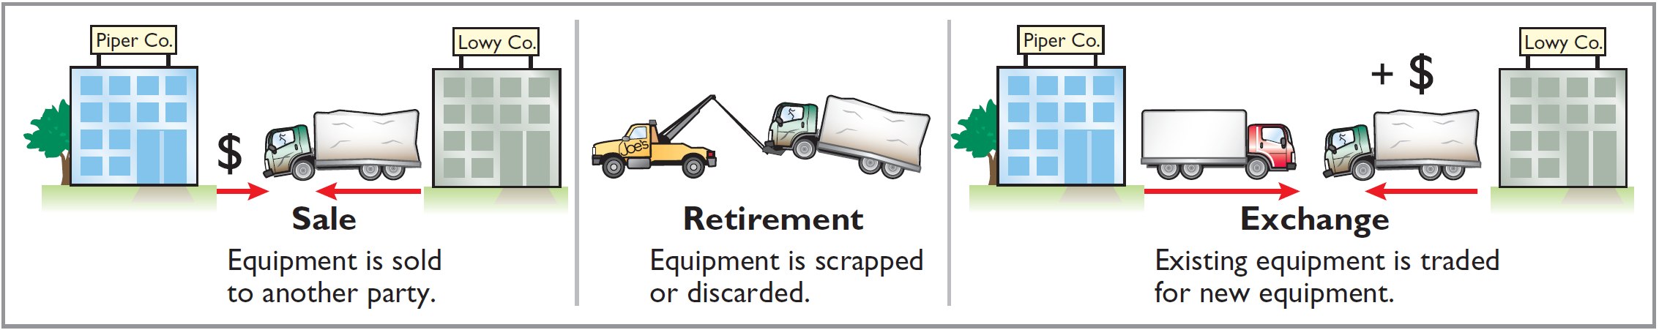
Plant Asset Disposals
Learning Objective 4
Explain how to account
for the disposal of a
plant asset.
Companies dispose of plant assets in three ways—Sale, Retirement, or Exchange.
Illustration 9-19
Methods of plant asset disposal
Record depreciation up to the date of disposal.
Eliminate asset by (1) debiting Accumulated Depreciation, and (2) crediting the asset account.
LO 4

Slide 50
Plant Asset Disposals
RETIREMENT OF PLANT ASSETS
  No cash is received.
  Decrease (debit) Accumulated Depreciation for the full amount of depreciation taken over the life of the asset.
  Decrease (credit) the asset account for the original cost of the asset.
  Record any difference loss on disposal.
LO 4

Slide 51
RETIREMENT OF PLANT ASSETS
Illustration: Hobart ASA retires its computer printers, which cost €32,000. The accumulated depreciation on these printers is €32,000. Prepare the entry to record this retirement.
Accumulated Depreciation—Equipment 32,000
Equipment 32,000
Question: What happens if a fully depreciated plant asset is still useful to the company?
LO 4

Slide 52
RETIREMENT OF PLANT ASSETS
Illustration: Sunset A/S discards delivery equipment that cost €18,000 and has accumulated depreciation of €14,000. The journal entry is?
Accumulated Depreciation—Equipment 14,000
Loss on Disposal of Plant Assets 4,000
Equipment 18,000
Companies report a loss on disposal in the “Other income and expense” section of the income statement.
LO 4

Slide 53
Plant Asset Disposals
SALE OF PLANT ASSETS
Compare the book value of the asset with the proceeds received from the sale.
    If proceeds exceed the book value, a gain on disposal occurs.
    If proceeds are less than the book value, a loss on disposal occurs.
LO 4

Slide 54
SALE OF PLANT ASSETS
GAIN ON SALE
Illustration: On July 1, 2017, Wright Company sells office furniture for €16,000 cash. The office furniture originally cost €60,000. As of January 1, 2017, it had accumulated depreciation of €41,000. Depreciation for the first six months of 2017 is €8,000. Prepare the journal entry to record depreciation expense up to the date of sale (July 1).
Depreciation Expense 8,000
Accumulated Depreciation—Equipment 8,000
LO 4

Slide 55
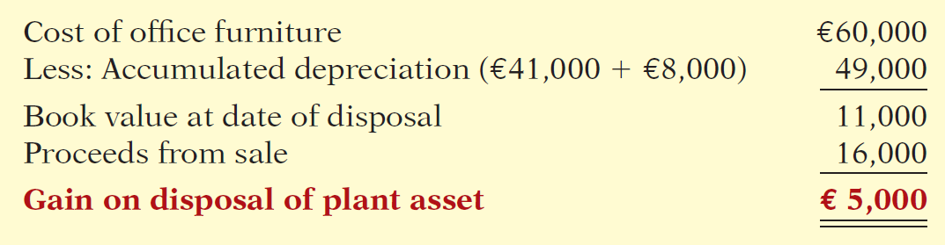
SALE OF PLANT ASSETS
Illustration 9-20
Computation of gain on disposal
Illustration: Wright records the sale on July 1 as follows.
Cash 16,000
Accumulated Depreciation—Equipment 49,000
Equipment 60,000
Gain on Disposal of Plant Assets 5,000
LO 4

Slide 56
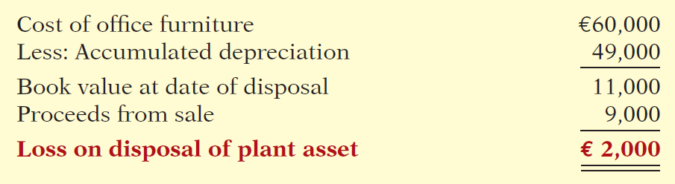
SALE OF PLANT ASSETS
Illustration: Assume that instead of selling the office furniture for €16,000, Wright sells it for €9,000 on July 1.
Illustration 9-21
Computation of loss on disposal
July 1
Cash 9,000
Accumulated Depreciation—Equipment 49,000
Loss on Disposal of Plant Assets 2,000
Equipment 60,000
LO 4

Slide 57
>
DO IT!
Overland Trucking has an old truck that cost £30,000 and has accumulated depreciation of £16,000. Assume two different situations:
Overland sells the old truck for £17,000 cash.
Overland sells the old truck for £10,000 cash.
What entry should Overland use to record scenario 1?
Cash 17,000
Accumulated Depreciation—Equipment 16,000
Equipment 30,000
Gain on Disposal of Plant Assets 3,000
LO 4

Slide 58
>
DO IT!
Overland Trucking has an old truck that cost £30,000 and has accumulated depreciation of £16,000. Assume two different situations:
Overland sells the old truck for £17,000 cash.
Overland sells the old truck for £10,000 cash.
What entry should Overland use to record scenario 2?
Cash 10,000
Accumulated Depreciation—Equipment 16,000
Loss on Disposal of Plant Assets 4,000
Equipment 30,000
LO 4

Slide 59
Extractable Natural Resources
Learning Objective 5
Compute periodic
depletion of
extractable natural
resources.
Natural resources consist of standing timber
and resources extracted from the ground, such
as oil, gas, and minerals.
IFRS defines extractive industries as those businesses involved in finding and removing natural resources located in or near the earth’s crust.
Standing timber is considered a biological asset under IFRS. In the years before they are harvested, the recorded value of biological assets is adjusted to fair value each period.
LO 5

Slide 60
Extractable Natural Resources
Acquisition cost of an extractable natural resource is the
  price needed to acquire the resource and
  prepare it for its intended use.
Depletion is the allocation of the cost to expense in a rational and systematic manner over the resource’s useful life.
  Depletion is to natural resources as depreciation is to plant assets.
  Companies generally use units-of-activity method.
  Depletion generally is a function of the units extracted.
LO 5

Slide 61
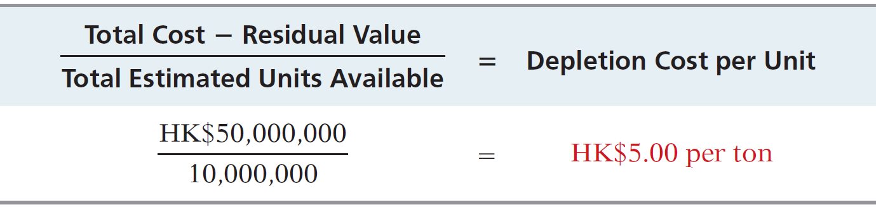
Extractable Natural Resources
Illustration: Lane Coal Company invests HK$50 million in a mine estimated to have 10 million tons of coal and no residual value. In the first year, Lane extracts and sells 250,000 tons of coal. Lane computes the depletion expense as follows:
Illustration 9-22
Computation of depletion cost per unit
HK$5.00 per ton x 250,000 tons =
HK$1,250,000 annual depletion
LO 5

Slide 62
Extractable Natural Resources
Illustration: Lane Coal Company invests HK$50 million in a mine estimated to have 10 million tons of coal and no residual value. In the first year, Lane extracts and sells 250,000 tons of coal. Lane records the depletion as follows:
Journal entry:
Inventory (coal) 1,250,000
Accumulated Depletion 1,250,000
LO 5

Slide 63
Intangible Assets
Learning Objective 6
Explain the basic
issues related to
accounting for
intangible assets.
Intangible assets are rights, privileges, and competitive advantages that result from ownership of long-lived assets that do not possess physical substance.
Limited life or indefinite life.
Common types of intangibles:
Patents
Copyrights
Trademarks
Trade Names
Goodwill
Franchises
Leases
LO 6

Slide 64
Accounting for Intangible Assets
Limited-Life Intangibles:
  Amortize to expense.
  Credit asset account.
Companies classify Amortization Expense as an operating expense in the income statement.
Indefinite-Life Intangibles:
  No amortization.
Similar to property, plant, and equipment, IFRS permits revaluation of intangible assets to fair value, except for goodwill.
LO 6

Slide 65
Accounting for Intangible Assets
PATENTS
Exclusive right to manufacture, sell, or otherwise control an invention for a specified number of years from the date of the grant.
Capitalize costs of purchasing a patent and amortize over its legal life or its useful life, whichever is shorter.
Expense any Research and Development costs in developing a patent.
Legal fees incurred successfully defending a patent are capitalized to Patents account.
LO 6

Slide 66
PATENTS
Illustration: National Labs purchases a patent at a cost of NT$720,000. National estimates the useful life of the patent to be eight years. National records the annual amortization for the ended December 31 as follows.
Cost NT$720,000
Useful life ÷ 8 years
Annual expense NT$ 90,000
Dec. 31
Amortization Expense 90,000
Patents 90,000
LO 6

Slide 67
Accounting for Intangible Assets
COPYRIGHTS
Give the owner the exclusive right to reproduce and sell an artistic or published work.
Granted for the life of the creator plus a specified number of years, commonly 70 years.
Capitalize costs of acquiring and defending it.
Amortized to expense over useful life.
LO 6

Slide 68
Accounting for Intangible Assets
TRADEMARKS AND TRADE NAMES
  Word, phrase, jingle, or symbol that identifies a particular enterprise or product.
    Wheaties, Monopoly, Kleenex, Coca-Cola, Big Mac, and Jetta.
  Legal protection for specified number of years, commonly 20 years. Protection may be renewal indefinitely.
  Capitalize cost of acquisition.
  No amortization.
LO 6

Slide 69
Accounting for Intangible Assets
FRANCHISES AND LICENSES
  Contractual arrangement between a franchisor and a franchisee.
    BP (GBR), Subway (USA), and Europcar are franchises.
  Franchise (or license) with a limited-life should be amortized to expense over its useful life.
  Franchise (or license) with an indefinite life is not amortized.
LO 6

Slide 70
Accounting for Intangible Assets
GOODWILL
Includes exceptional management, desirable location, good customer relations, skilled employees, high-quality products, etc.
Only recorded when an entire business is purchased.
Goodwill is recorded as the excess of cost over the fair value of the net assets acquired.
Internally created goodwill should not be capitalized.
Not amortized.
LO 6

Slide 71
Global Insight
Should Companies Write Up Goodwill?
SoftBank Corp. (JPN) at one time was the country’s largest Internet company. It boosted the profit margin of its mobile phone unit from 3.2% to 11.2% through what appeared to some as accounting tricks. What did it do? It wrote down the value of its mobile phone-unit assets by half. This would normally result in a huge loss. But rather than take a loss, the company wrote up goodwill by the same amount. How did this move increase earnings? The assets were being depreciated over 10 years, but the company amortizes goodwill over 20 years. (Amortization of goodwill was allowed under the accounting standards it followed at that time.) While the new treatment did not break any rules, the company was criticized by investors for not providing sufficient justification or a detailed explanation for the sudden shift in policy.
Source: Andrew Morse and Yukari Iwatani Kane, “SoftBank’s Accounting Shift Raises Eyebrows,” Wall Street Journal (August 28, 2007), p. C1.
LO 6

Slide 72
Research and Development Costs
Expenditures that may lead to
  patents,
  copyrights,
  new processes, and
  new products.
All R & D costs are expensed when incurred.
LO 6

Slide 73
Research and Development Costs
Illustration: Laser Scanner Ltd. spent NT$1 million on
research and NT$2 million on development of new products. Of the NT$2 million in development costs NT$400,000 was incurred prior to technological feasibility and NT$1,600,000 was incurred after technological feasibility had been demonstrated. The company would record these costs as follows.
Research and Development Expense 1,400,000
Development Costs 1,600,000
Cash 3,000,000
LO 6

Slide 74
Accounting for Intangible Assets
Question
Which of the following statements is false?
  If an intangible asset has a finite life, it should be amortized.
  The amortization period of an intangible asset can exceed 20 years.
  Goodwill is recorded only when a business is purchased.
  Development costs are always expensed when incurred.
LO 6

Slide 75
>
DO IT!
Illustration: Identify the term most directly associated with each statement.
1. The allocation of the cost of an extractable natural resource to expense in a rational and systematic manner.
2. Rights, privileges, and competitive advantages that result from the ownership of long-lived assets that do not possess physical substance.
3. An exclusive right granted by a government to reproduce and sell an artistic or published work.
Depletion
Intangible Assets
Copyrights
LO 6

Slide 76
>
DO IT!
Illustration: Identify the term most directly associated with each statement.
4. A right to sell certain products or services or to use certain trademarks or trade names within a designated geographic area.
5. Costs incurred by a company that often lead to patents or new products. These costs must be expensed as incurred.
Franchises
Research Costs
LO 6

Slide 77
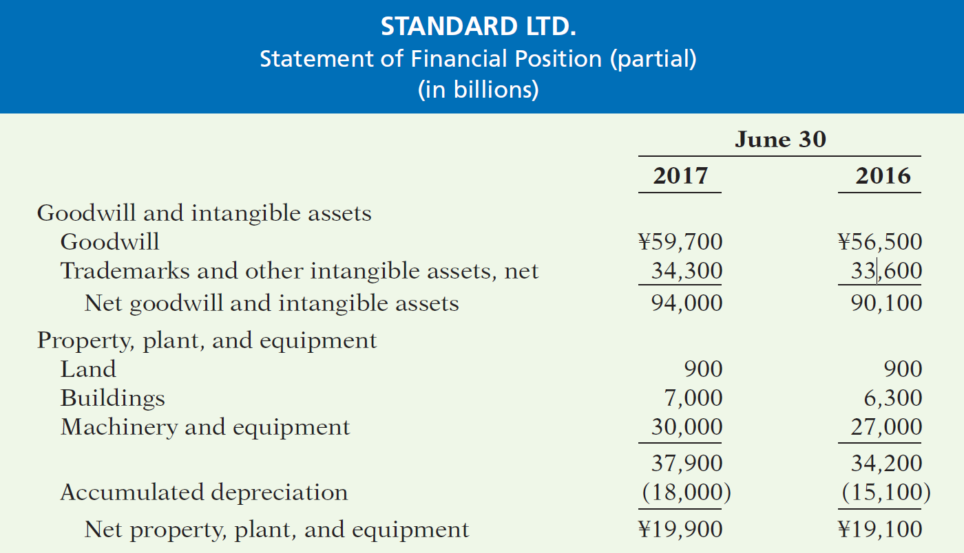
Statement Presentation
Learning Objective 7
Indicate how plant
assets, natural
resources, and
intangible assets
are reported.
Illustration 9-23
Presentation of property, plant, and equipment, and intangible assets
LO 7

Slide 78
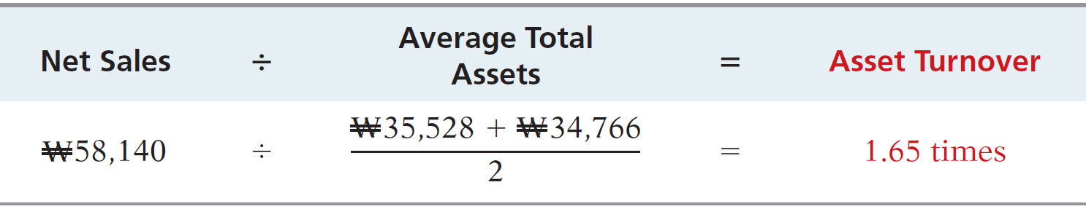
Statement Analysis
Illustration 9-24
Asset turnover formula and computation
Each Korean won invested in assets produced ₩1.65 in sales for LG. If a company is using its assets efficiently, each investment in assets will create a high amount of sales.
LO 7

Slide 79
>
DO IT!
Paramour Company reported net income of $180,000, net sales of $420,000, and had total assets of $460,000 on January 1, 2017, and total assets on December 31, 2017, of $540,000. Determine Paramour’s asset turnover for 2017.
Solution
The asset turnover is computed as follows.
Net Sales ÷ Average Total Assets = Asset Turnover
$460,000 + $540,000
$420,000 ÷
= .84
2
LO 7

Slide 80
APPENDIX 9A
Exchange of Plant Assets
Learning Objective 8
Explain how to account for the exchange of plant
assets.
Ordinarily, companies record a gain or
loss on the exchange of plant assets.
Most exchanges have commercial substance.
Commercial substance - if the future cash flows change as a result of the exchange.
LO 8

Slide 81
Loss Treatment
Illustration: Roland NV exchanged used trucks (cost €64,000 less €22,000 accumulated depreciation) plus cash of €17,000 for a new semi-truck. The used trucks had a fair market value of €26,000.
Cost of used trucks €64,000
Less: Accumulated depreciation 22,000
Book value 42,000
Fair market value of used trucks 26,000
Loss on disposal €16,000
Fair market value of used trucks €26,000
Cash paid 17,000
Cost of semi-truck €43,000
Illustration 9A-2
Computation of loss on disposal
Illustration 9A-1
Cost of semi-truck
LO 8

Slide 82
Loss Treatment
Illustration: Roland NV exchanged used trucks (cost €64,000 less €22,000 accumulated depreciation) plus cash of €17,000 for a new semi-truck. The old trucks had a fair market value of €26,000.
Prepare the entry to record the exchange of assets by Roland NV.
Equipment (new) 43,000
Accumulated Depreciation—Equipment 22,000
Loss on Disposal of Plant Assets 16,000
Equipment (old) 64,000
Cash 17,000
LO 8

Slide 83
Gain Treatment
Illustration: Mark Express trades its old delivery equipment (cost €40,000 less €28,000 accumulated depreciation) for new delivery equipment. The old equipment had a fair market value of €19,000. Mark also paid €3,000.
Cost of old equipment €40,000
Less: Accumulated depreciation 28,000
Book value 12,000
Fair market value of old equipment 19,000
Gain on disposal € 7,000
Fair market value of old equipment €19,000
Cash paid 3,000
Cost of new equipment €22,000
Illustration 9A-4
Computation of gain
on disposal
Illustration 9A-3
Cost of new delivery equipment
LO 8

Slide 84
Gain Treatment
Illustration: Mark Express trades its old delivery equipment (cost €40,000 less €28,000 accumulated depreciation) for new delivery equipment. The old equipment had a fair market value of €19,000. Mark also paid €3,000.
Prepare the entry to record the exchange of assets by Mark Express.
Equipment (new) 22,000
Accumulated Depreciation—Equipment (old) 28,000
Equipment (old) 40,000
Gain on Disposal of Plant Assets 7,000
Cash 3,000
LO 8

Slide 85
Exchange of Plant Assets
Question
In exchanges of assets in which the exchange has commercial substance:
  neither gains nor losses are recognized immediately.
  gains, but not losses, are recognized immediately.
  losses, but not gains, are recognized immediately.
  both gains and losses are recognized immediately.
LO 8

Slide 86
A Look at U.S. GAAP
Learning Objective 9
Compare the accounting for long-lived assets under IFRS and U.S. GAAP.
Key Points
Similarities
  The definition for plant assets for both GAAP and IFRS is essentially the same.
  GAAP, like IFRS, capitalizes all direct costs in self-constructed assets such as raw materials and labor. IFRS does not address the capitalization of fixed overhead although in practice these costs are generally capitalized.
  GAAP also views depreciation as an allocation of cost over an asset’s useful life. GAAP permits the same depreciation methods (e.g., straight-line, accelerated, and units-of-activity) as IFRS.
  The accounting for subsequent expenditures, such as ordinary repairs and additions, are essentially the same under GAAP and IFRS.
LO 9

Slide 87
A Look at U.S. GAAP
Key Points
Differences
  Under GAAP, an item of property, plant, and equipment with multiple parts is generally depreciated over the useful life of the total asset. Thus, component depreciation is generally not used. However, GAAP permits companies to use component depreciation.
  GAAP uses the term salvage value, rather than residual value, to refer to an owner’s estimate of an asset’s value at the end of its useful life for that owner.
  IFRS allows companies to revalue plant assets to fair value at the reporting date.
LO 9

Slide 88
A Look at U.S. GAAP
Key Points
Differences
  As in IFRS, under GAAP the costs associated with research and development are segregated into the two components. Costs in the research phase are always expensed under both GAAP and IFRS. Under IFRS, however, costs in the development phase are capitalized as Development Costs once technological feasibility is achieved. Under GAAP, all development costs are expensed as incurred.
  IFRS permits revaluation of intangible assets (except for goodwill). GAAP prohibits revaluation of intangible assets.
LO 9

Slide 89
A Look at U.S. GAAP
Key Points
Differences
  IFRS requires an impairment test at each reporting date for plant assets and intangibles and records an impairment if the asset’s carrying amount exceeds its recoverable amount. The recoverable amount is the higher of the asset’s fair value less costs to sell or its value-in-use. Value-in-use is the future cash flows to be derived from the particular asset, discounted to present value. Under GAAP, impairment loss is measured as the excess of the carrying amount over the asset’s fair value.
  IFRS allows reversal of impairment losses when there has been a change in economic conditions or in the expected use of the asset. Under GAAP, impairment losses cannot be reversed for assets to be held and used; the impairment loss results in a new cost basis for the asset. IFRS and GAAP are similar in the accounting for impairments of assets held for disposal.
LO 9

Slide 90
A Look at U.S. GAAP
Looking to the Future
  With respect to revaluations, as part of the conceptual framework project, the Boards will examine the measurement bases used in accounting. It is too early to say whether a converged conceptual framework will recommend fair value measurement (and revaluation accounting) for plant assets and intangibles. However, this is likely to be one of the more contentious issues, given the longstanding use of historical cost as a measurement basis in GAAP. The IASB and FASB have identified a project that would consider expanded recognition of internally generated intangible assets. IFRS permits more recognition of intangibles compared to GAAP. Thus, it will be challenging to develop converged standards for intangible assets, given the long-standing prohibition on capitalizing internally generated intangible assets and research and development costs in GAAP.
LO 9

Slide 91
A Look at U.S. GAAP
A Look at IFRS
GAAP Self-Test Questions
Which of the following statements is correct?
  Both IFRS and GAAP permit revaluation of property, plant, and equipment and intangible assets (except for goodwill).
  IFRS permits revaluation of property, plant, and equipment and intangible assets (except for goodwill).
  Both IFRS and GAAP permit revaluation of property, plant, and equipment but not intangible assets.
  GAAP permits revaluation of property, plant, and equipment but not intangible assets.
LO 9

Slide 92
A Look at U.S. GAAP
A Look at IFRS
GAAP Self-Test Questions
Research and development costs are:
  expensed under GAAP.
  expensed under IFRS.
  expensed under both GAAP and IFRS.
  None of the above.
LO 9

Slide 93
A Look at U.S. GAAP
A Look at IFRS
GAAP Self-Test Questions
Value-in-use is defined as:
  net realizable value.
  fair value.
  future cash flows discounted to present value.
  total future undiscounted cash flows.
LO 9

Slide 94
Copyright
“Copyright © 2016 John Wiley & Sons, Inc. All rights reserved. Reproduction or translation of this work beyond that permitted in Section 117 of the 1976 United States Copyright Act without the express written permission of the copyright owner is unlawful. Request for further information should be addressed to the Permissions Department, John Wiley & Sons, Inc. The purchaser may make back-up copies for his/her own use only and not for distribution or resale. The Publisher assumes no responsibility for errors, omissions, or damages, caused by the use of these programs or from the use of the information contained herein.”

